Slide 1


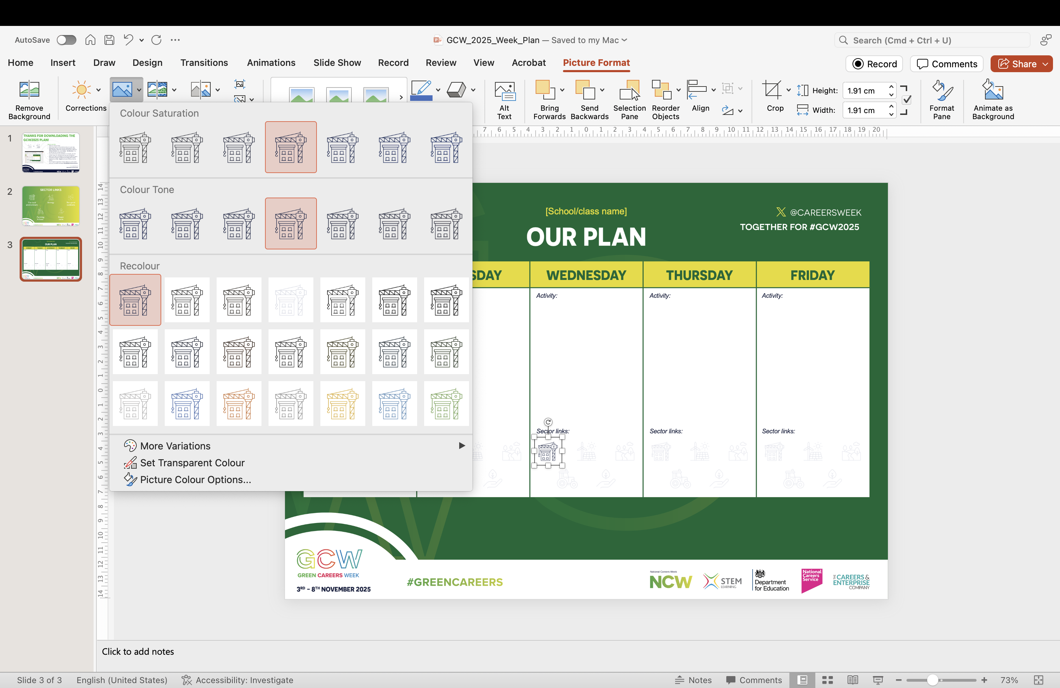
How to use this:
Add your school name.
Add a description of the GCW activities for each day.
Highlight the sector icons that are applicable for each day’s activities. Select the relevant icon(s) and, under the ‘Picture Format’ tab, select Colour > No Recolour. You should see your icon(s) stand out.
If you can’t fit all of your activities on one plan, you can create copies for individual year groups and glasses.
When your plan is complete, you can print copies to place around your school or export as an image file to share digitally! Go to File > Export and select JPEG as the file format.
Don’t forget to tag Green Careers Week on social media and use our official hashtags: #GCW2025 #GreenCareers

Slide 2


Slide 3
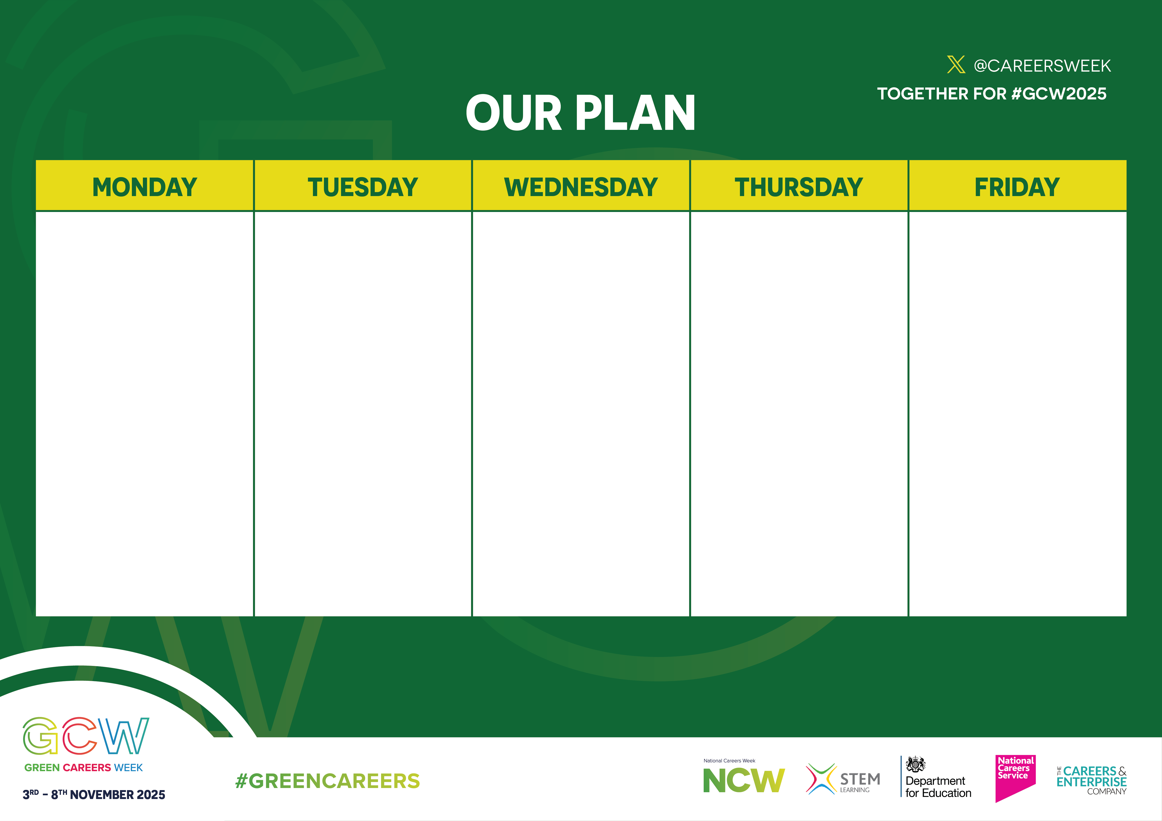




[School/class name]
Activity:
Activity:
Activity:
Activity:
Activity:
Sector links:
Sector links:
Sector links:
Sector links:
Sector links:

